Slide 1
we are
articulate.

Slide 2
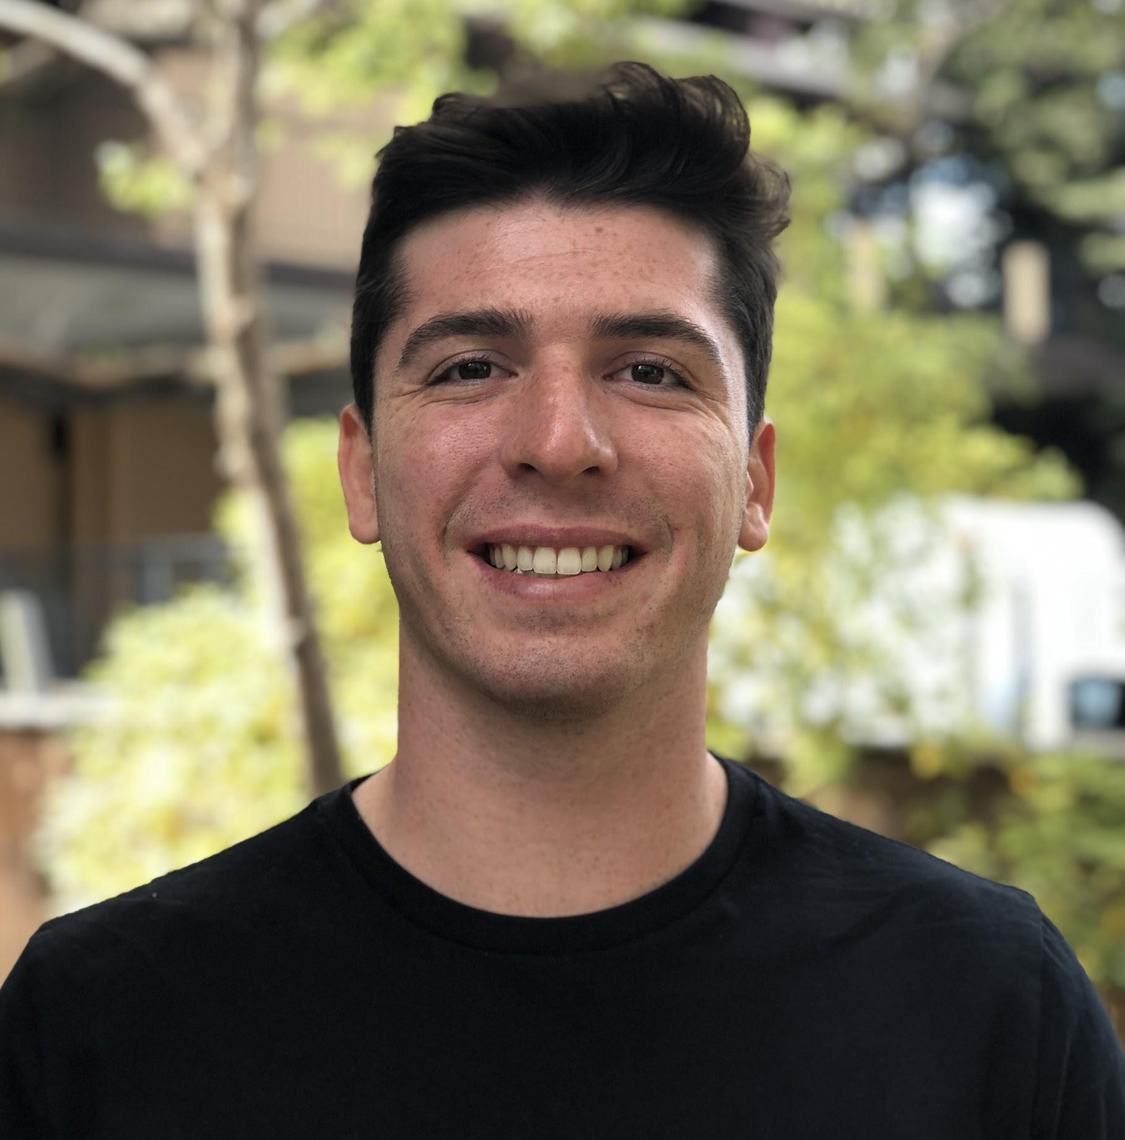
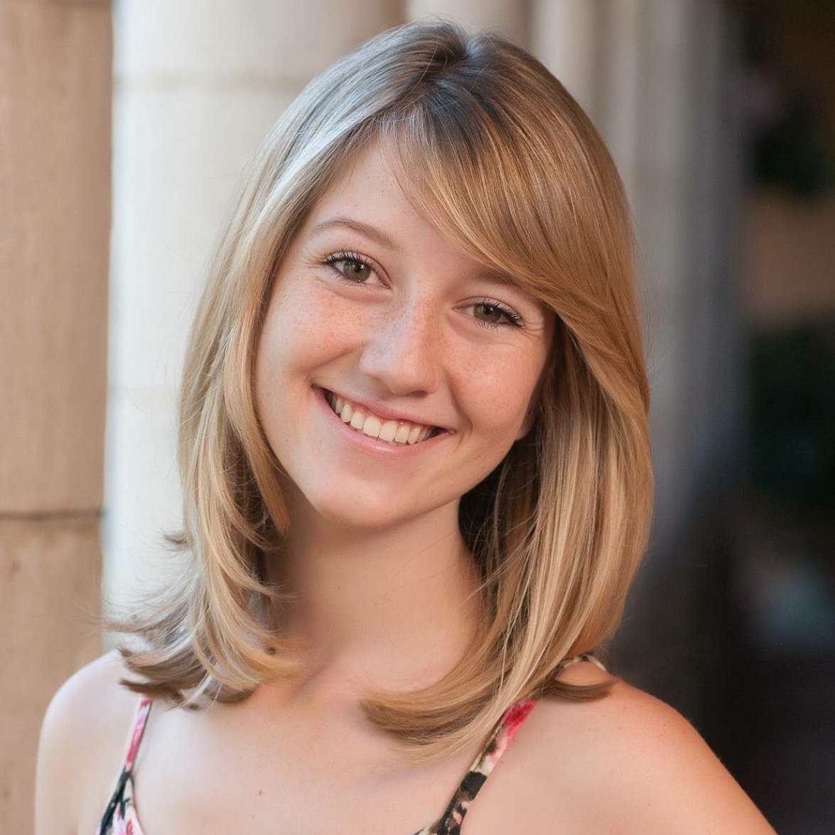
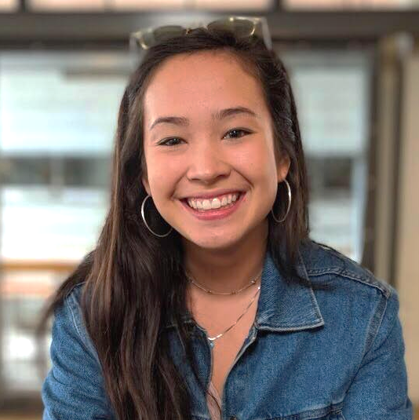
the articulate team
Zach Goodale
zgoodale@stanford.edu
Lexi Stein
lexi@stanford.edu
Vincent Nicandro
nicandro@stanford.edu
Casey Wong
wongcs@stanford.edu

Slide 3
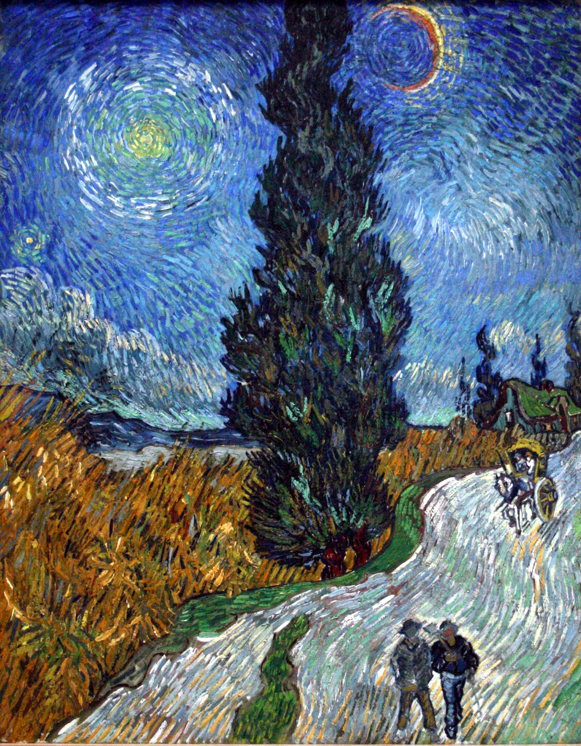
The Problem Domain
Art Accessibility
Art is for everyone
1
Access to art education

Slide 4
The Problem Domain
Art Accessibility
Art is for everyone
1
Access to art education
2
Inspiration

Slide 5
The Problem Domain
Art Accessibility
Art is for everyone
1
Access to art education
2
Inspiration
3
Creative outlets

Slide 6
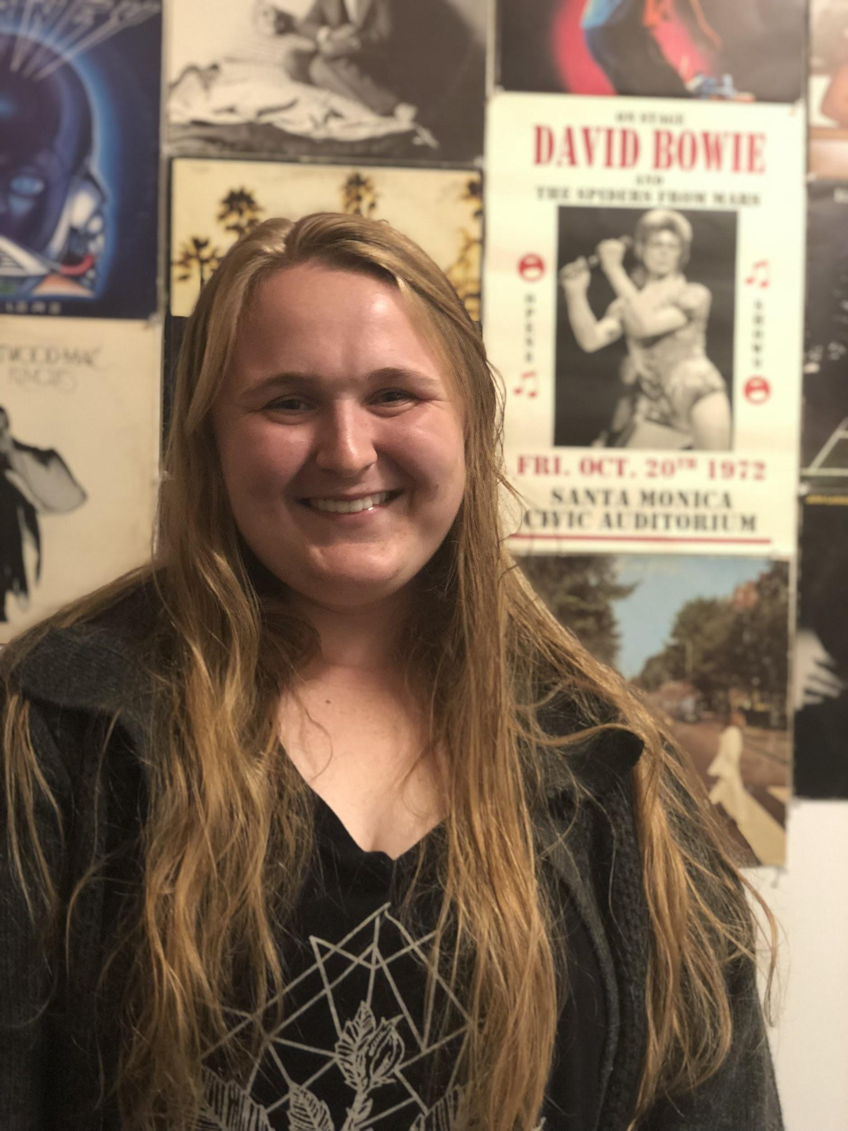
Kylee
Junior, Stanford
Human Biology Major
1
We met a student named Kylee, who loves to paint and listen to music

Slide 7
Kylee
Junior, Stanford
Human Biology Major
1
We met a student named Kylee, who loves to paint and listen to music
2
We were surprised to hear she feels detached from her artwork

Slide 8
Kylee
Junior, Stanford
Human Biology Major
1
We met a student named Kylee, who loves to paint and listen to music
2
We were surprised to hear she feels detached from her artwork
3
It would be game-changing to remind creators that are can be raw, messy, and accessible

Slide 9
extended
needfinding

Slide 10
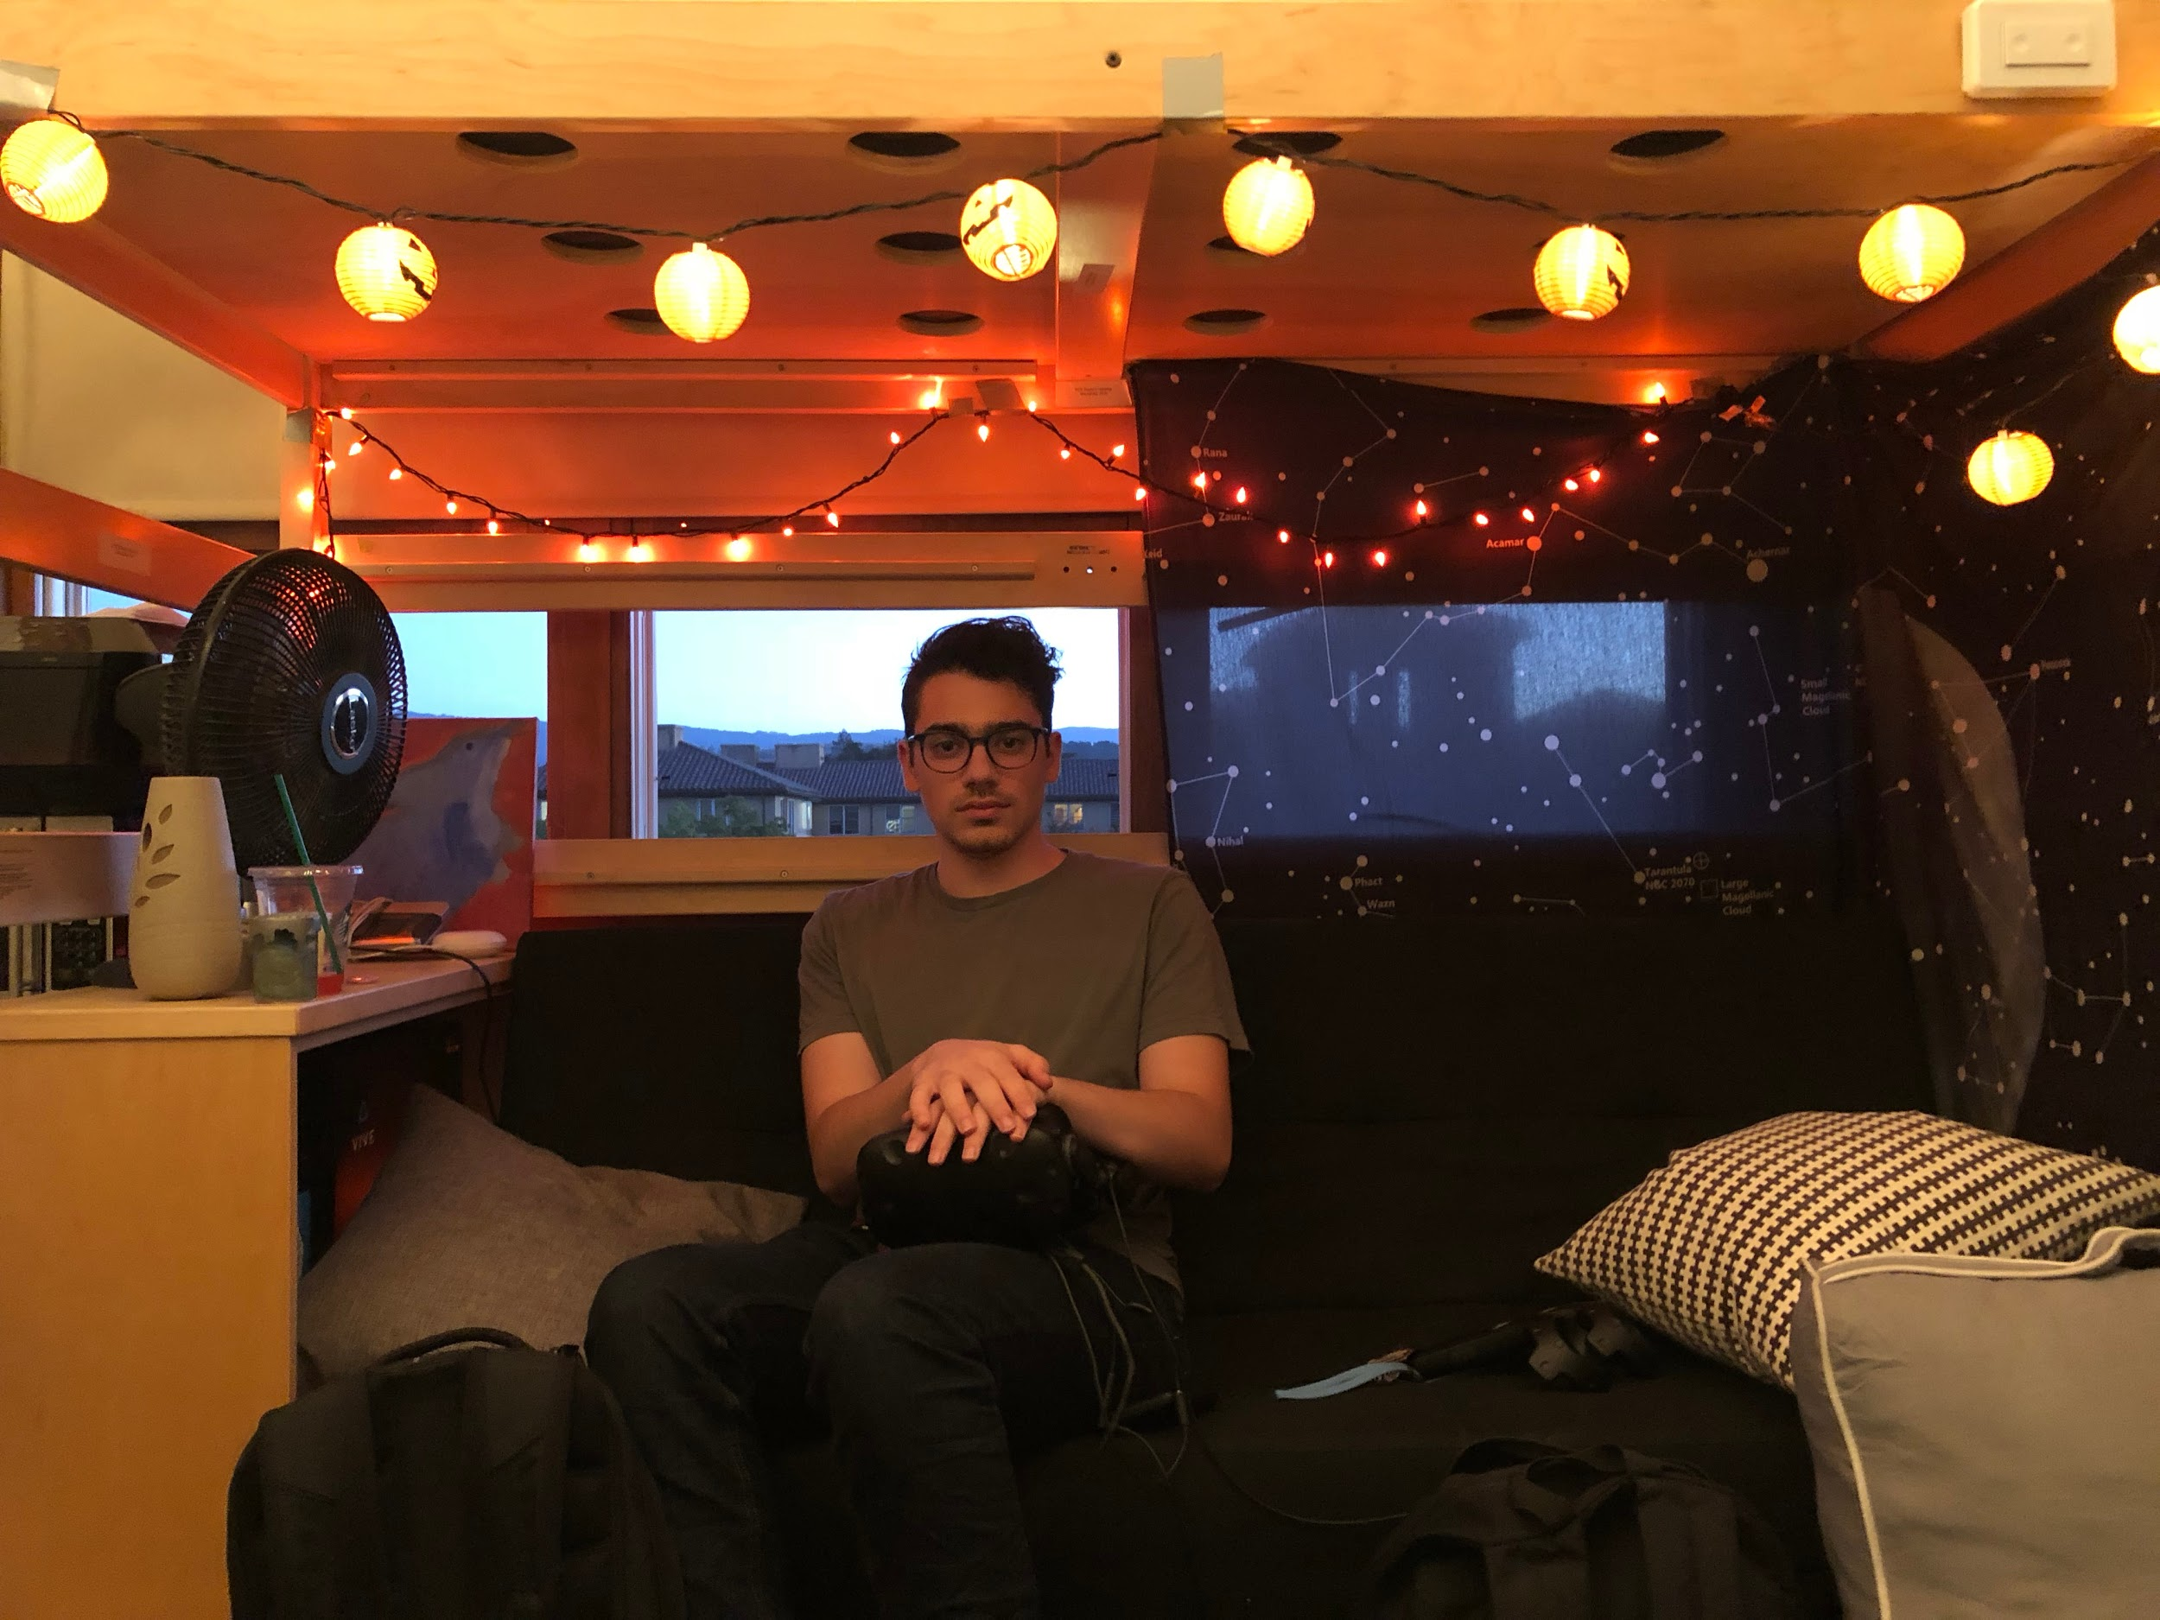
Jared
Junior, Stanford
Songwriter + Music Production
1
Put music production on the backburner

Slide 11
Jared
Junior, Stanford
Songwriter + Music Production
1
Put music production on the backburner
2
Difficulty learning tools to produce music

Slide 12
Jared
Junior, Stanford
Songwriter + Music Production
1
Put music production on the backburner
2
Difficulty learning tools to produce music
3
Wants to be connected to experts

Slide 13
Anna
Junior, Stanford
Varsity Squash Player
1
Judged by her labels

Slide 14
Anna
Junior, Stanford
Varsity Squash Player
1
Judged by her labels
2
“Pre-med” & “athlete” Unartistic

Slide 15
Anna
Junior, Stanford
Varsity Squash Player
1
Judged by her labels
2
“Pre-med” & “athlete” Unartistic
3
Wants to feel artistic

Slide 16
revised pov’s + hmw’s

Slide 17
Kylee
Junior, Stanford
Human Biology Major
1
We met a student named Kylee, who loves to paint and listen to music
2
We were surprised to hear she feels detached from her artwork
3
It would be game-changing to remind creators that are can be raw, messy, and accessible

Slide 18
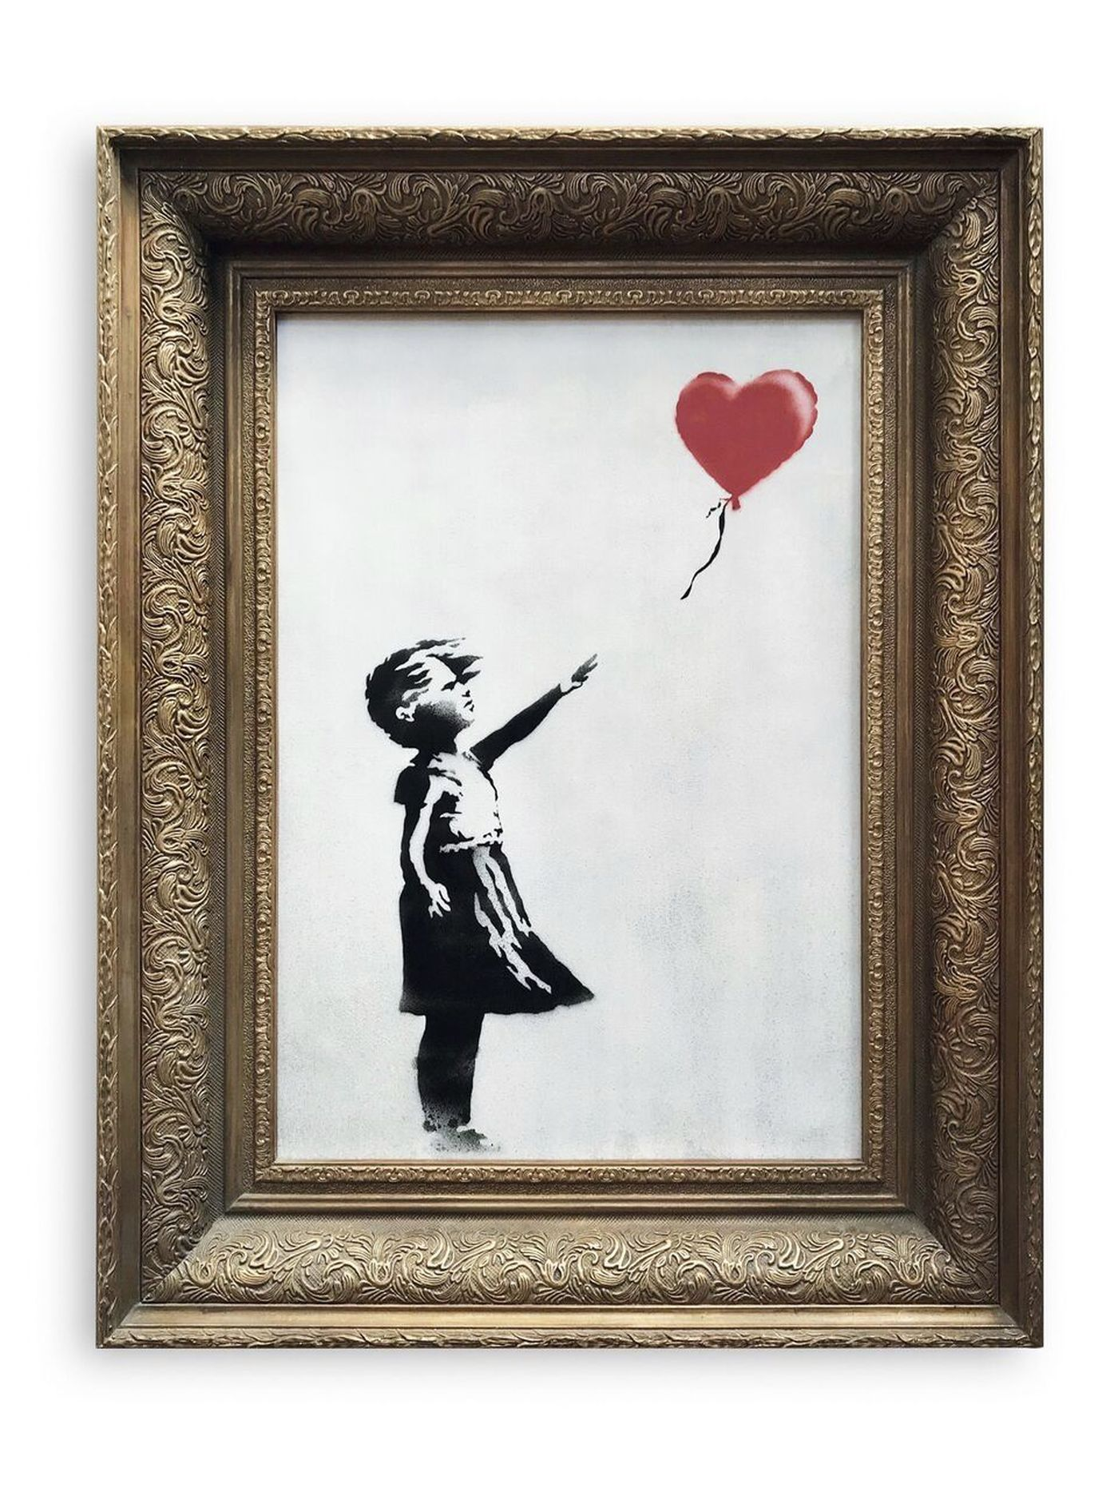
How Might We...
Encourage Unfiltered Creation
Art isn’t precious...
1
Digital art w/ No Erase Button

Slide 19
How Might We...
Encourage Unfiltered Creation
Art isn’t precious...
1
Digital art w/ No Erase Button
2
Challenge to switch prompts/mediums halfway through

Slide 20
How Might We...
Encourage Unfiltered Creation
Art isn’t precious...
1
Digital art w/ No Erase Button
2
Challenge to switch prompts/mediums halfway through
3
Self-Destructing Art

Slide 21
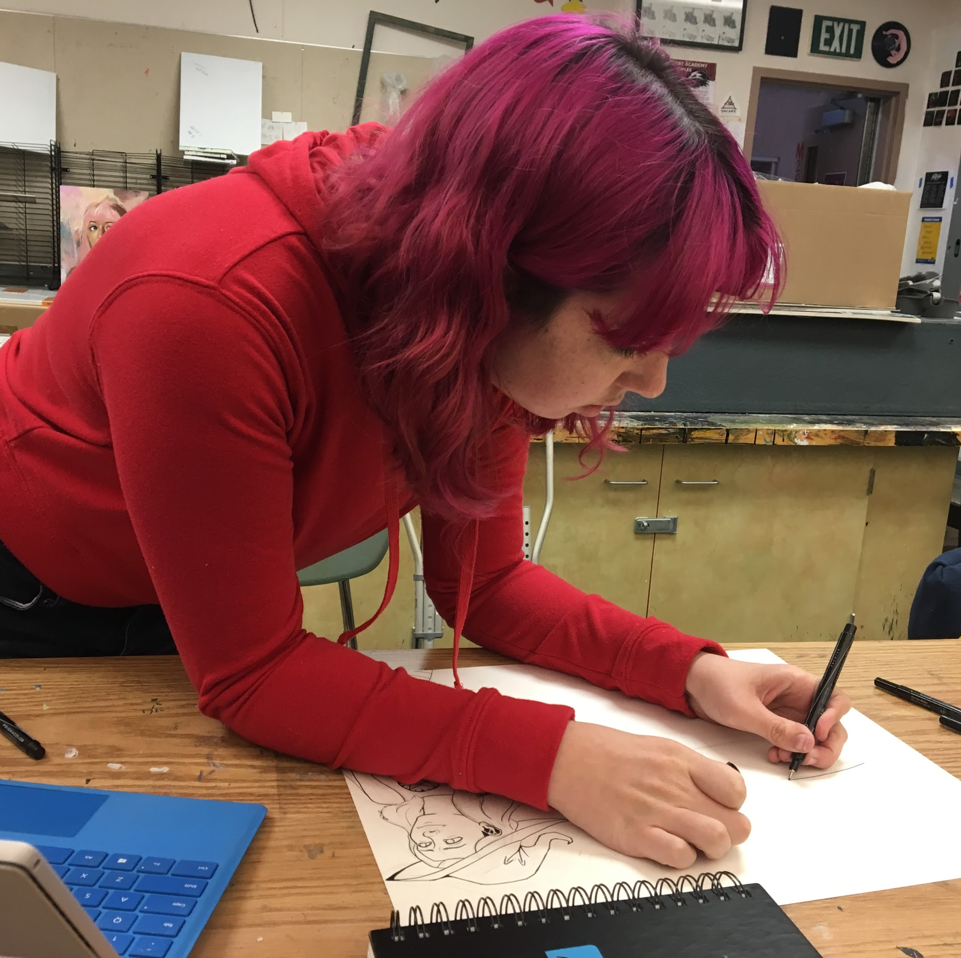
Nicole Stein
Senior, High School
Illustrator + Painter
1
We met an artist named Nicole, who struggled to find reference photos for her art

Slide 22
Nicole Stein
Senior, High School
Illustrator + Painter
1
We met an artist named Nicole, who struggled to find reference photos for her art
2
We were surprised to hear Google often did not satisfy her needs for reference photos

Slide 23
Nicole Stein
Senior, High School
Illustrator + Painter
1
We met an artist named Nicole, who struggled to find reference photos for her art
2
We were surprised to hear Google often did not satisfy her needs for reference photos
3
It would be game-changing to provide a platform to make inspiration for her art more accessible

Slide 24
How Might We...
Connect Artists
So they can share with each other
1
Artist Tinder

Slide 25
How Might We...
Connect Artists
So they can share with each other
1
Artist Tinder
2
Social Media for art

Slide 26
How Might We...
Connect Artists
So they can share with each other
1
Artist Tinder
2
Social Media for art
3
Coffee Dates

Slide 27
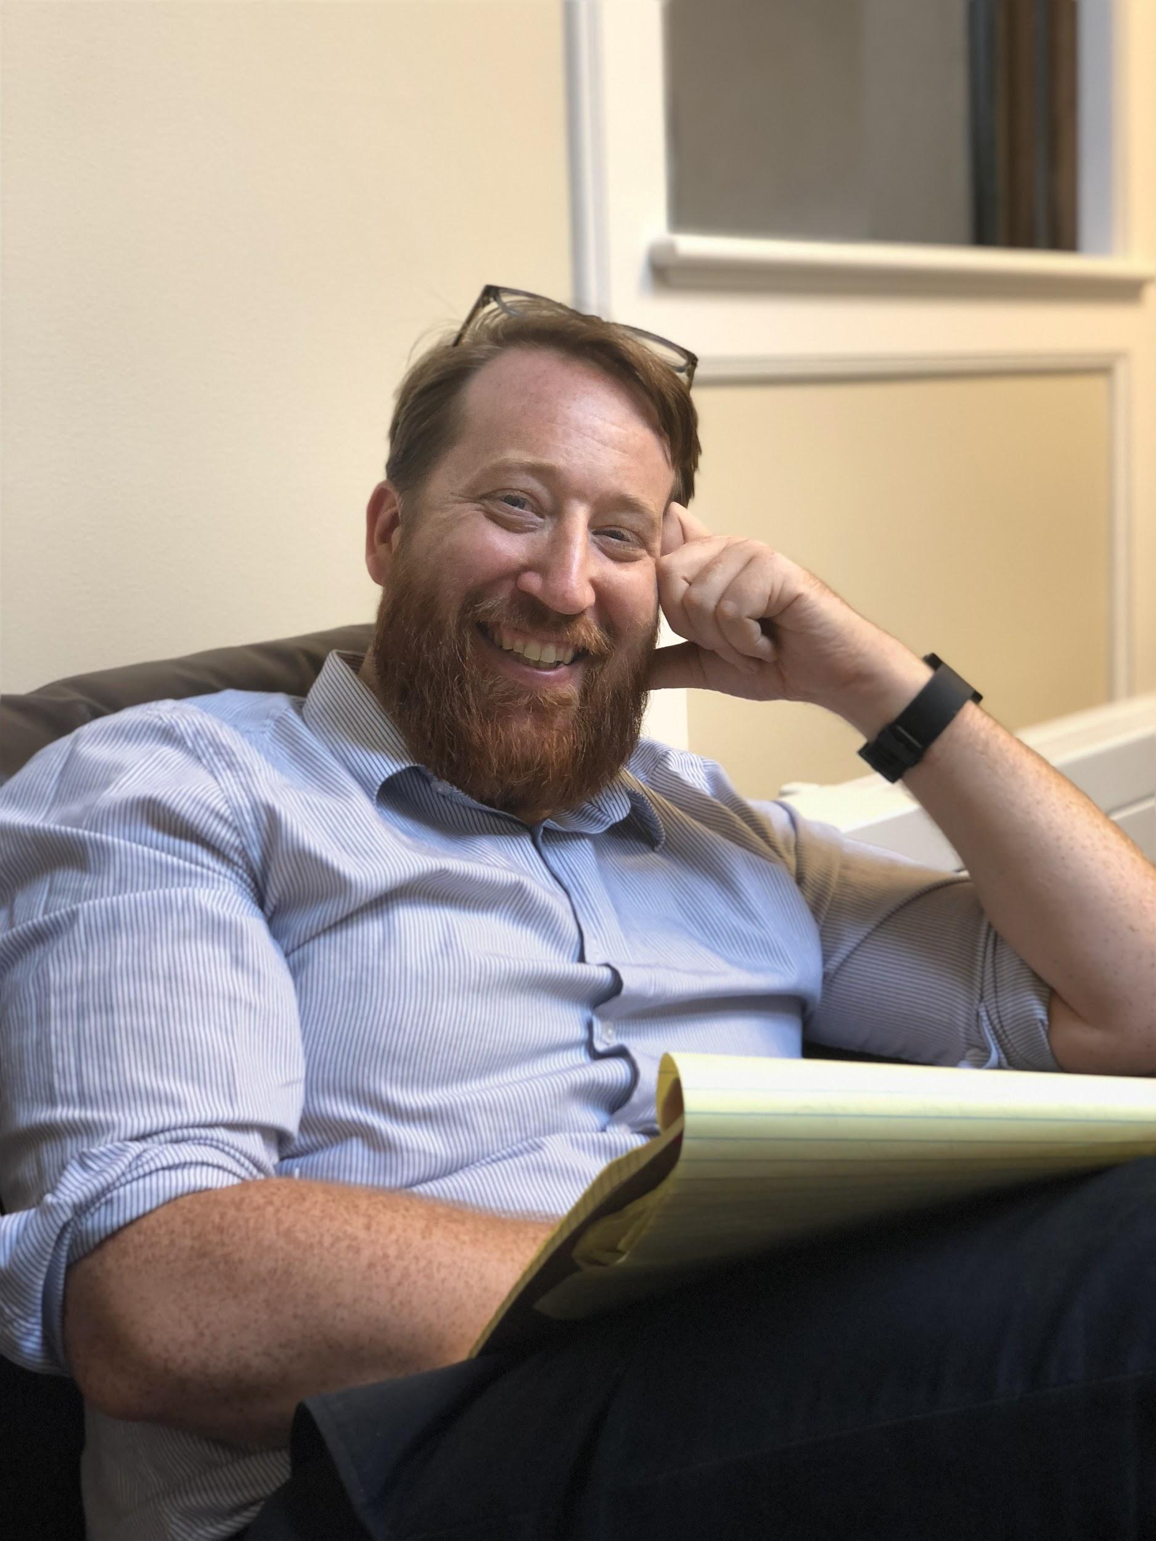
Michael Rau
Professor, Stanford
Director + Theater Maker
1
We met an professor name Michael who is frustrated with the departmentalization of art

Slide 28
Michael Rau
Professor, Stanford
Director + Theater Maker
1
We met an professor name Michael who is frustrated with the departmentalization of art
2
We were surprised to hear this frustration was influenced by his interest in art + tech

Slide 29
Michael Rau
Professor, Stanford
Director + Theater Maker
1
We met an professor name Michael who is frustrated with the departmentalization of art
2
We were surprised to hear this frustration was influenced by his interest in art + tech
3
It would be game-changing to facilitate the integration of art with other disciplines

Slide 30
How Might We...
Make Art Accessible
To those that don’t identify as artists
1
Connect artists with non-artists

Slide 31
How Might We...
Make Art Accessible
To those that don’t identify as artists
1
Connect artists with non-artists
2
Create an Educational Platform

Slide 32
How Might We...
Make Art Accessible
To those that don’t identify as artists
1
Connect artists with non-artists
2
Create an Educational Platform
3
Organized Art Challenges

Slide 33
experience
prototypes

Slide 34
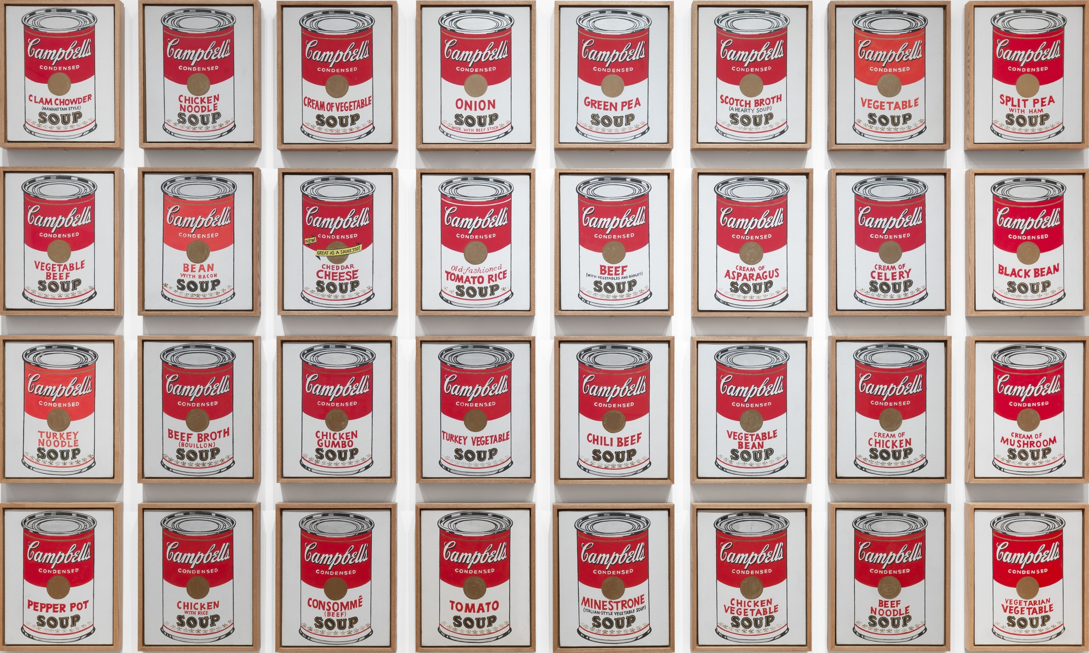
ARt
ARt
Artwork Identified
Campbell’s Soup Cans
Andy Warhol, 1962
Augmented Reality Educator
1
Let you identify artwork

Slide 35
ARt
ARt
Artwork Identified
Campbell’s Soup Cans
Andy Warhol, 1962
Augmented Reality Educator
1
Let you identify artwork
2
Help you understand significance
Andy Warhol famously appropriated familiar images from consumer culture and mass media. Click for More

Slide 36
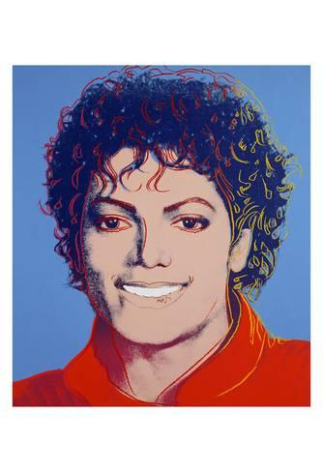
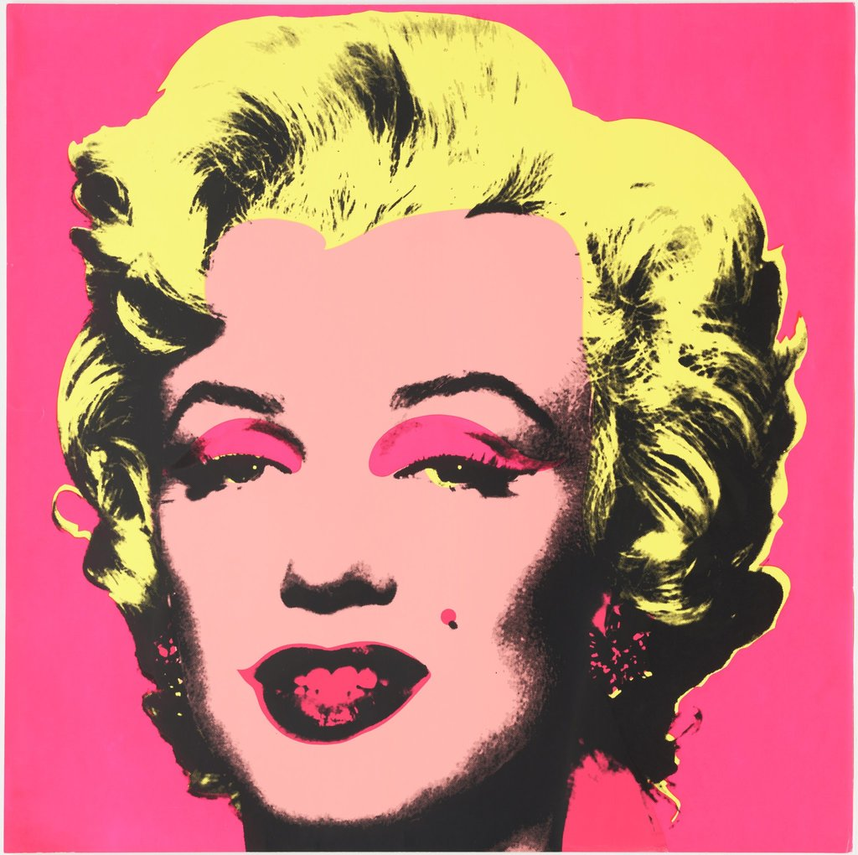
ARt
ARt
Artwork Identified
Campbell’s Soup Cans
Andy Warhol, 1962
Augmented Reality Educator
1
Let you identify artwork
2
Help you understand significance
3
Offer more
Andy Warhol famously appropriated familiar images from consumer culture and mass media. Click for More
More Like This:

Slide 37
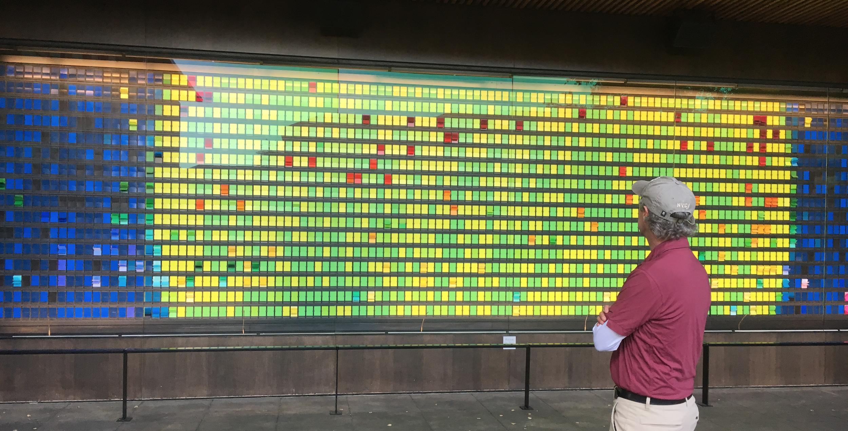
ARt
ARt
Artwork Identified
Experience Prototype
1
Did not know context about the installation
Mark Talbott
Squash Coach

Slide 38
ARt
ARt
Artwork Identified
Experience Prototype
1
Did not know context about the installation
2
Mark pulled out his phone
Mark Talbott
Squash Coach

Slide 39
ARt
ARt
Artwork Identified
Experience Prototype
1
Did not know context about the installation
2
Mark pulled out his phone
Mark Talbott
Squash Coach
3
ARt filled him in

Slide 40
ARt
ARt
Artwork Identified
ARt
Artwork Identified
Experience Prototype
1
What Worked: “Easier than pulling up Wikipedia”
Mark Talbott
Squash Coach

Slide 41
ARt
ARt
Artwork Identified
ARt
Artwork Identified
Experience Prototype
1
What Worked: “Easier than pulling up Wikipedia”
2
What Didn’t: The fact that info is already online
Mark Talbott
Squash Coach

Slide 42
ARt
ARt
Artwork Identified
ARt
Artwork Identified
Experience Prototype
1
What Worked: “Easier than pulling up Wikipedia”
2
What Didn’t: The fact that info is already online
Mark Talbott
Squash Coach
3
Surprises: Values spontaneity

Slide 43
ARt
ARt
Artwork Identified
ARt
Artwork Identified
Experience Prototype
1
What Worked: “Easier than pulling up Wikipedia”
2
What Didn’t: The fact that info is already online
Mark Talbott
Squash Coach
3
Surprises: Values spontaneity
4
New Learnings: Accessibility encourages education

Slide 44
Assumption Valid
People are interested in easily accessible art information

Slide 45
Artbot
Draw me a Dog!
Art
bot
Antagonistic, Artful Companion
1
Give you an art prompt

Slide 46
Artbot
Whoops ;)
Art
bot
Antagonistic, Artful Companion
1
Give you an art prompt
2
Disrupt your artwork partway through

Slide 47
Artbot
Good job!
Art
bot
Antagonistic, Artful Companion
1
Give you an art prompt
2
Disrupt your artwork partway through
3
Reward imperfection

Slide 48
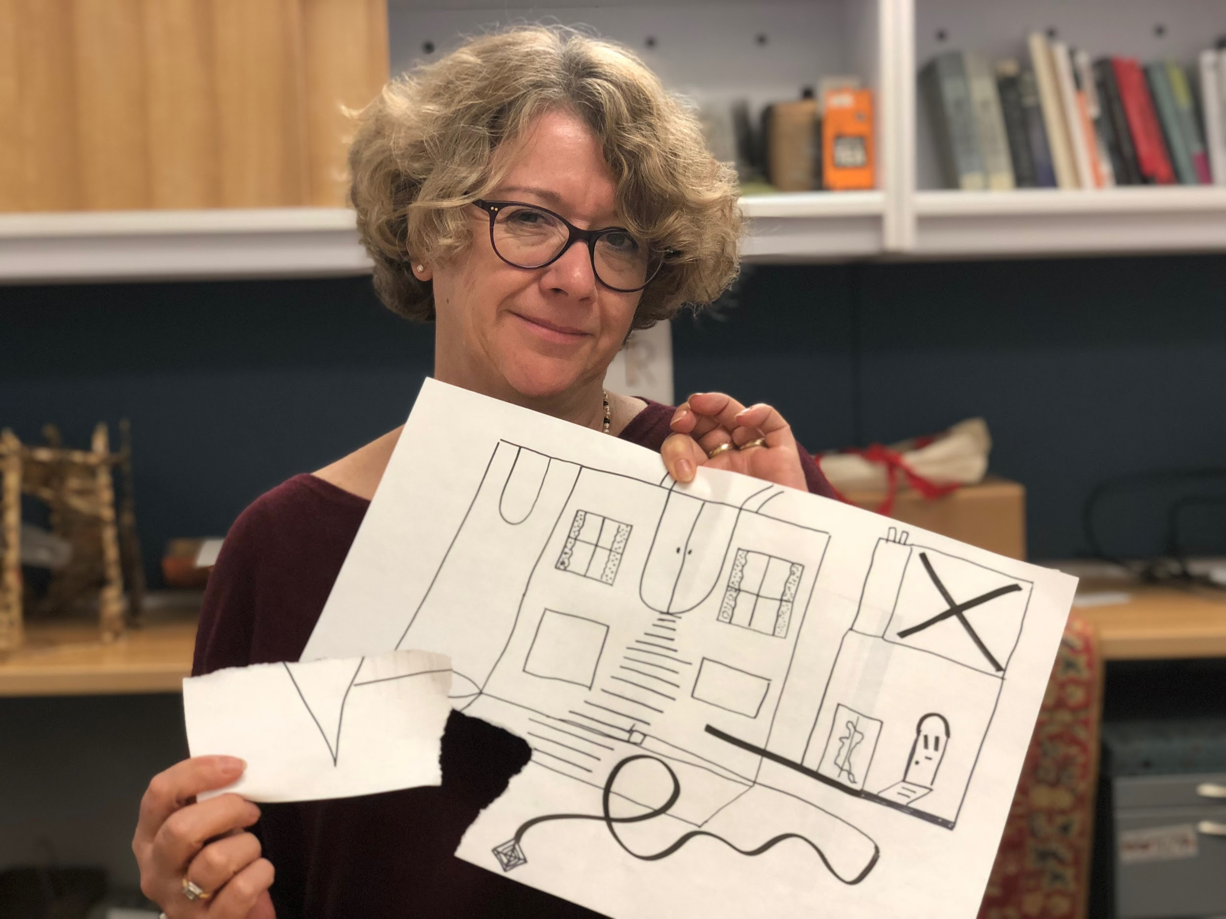
Artbot
Experience Prototype
1
Elaine given prompt and told about the intended disruption
Dr. Elaine Treharne
English Professor

Slide 49
Artbot
So sorry about that!
Art
bot
Experience Prototype
1
Elaine given prompt and told about the intended disruption
2
Sharpie scribble, paper torn, picture inverted
Dr. Elaine Treharne
English Professor

Slide 50
Artbot
So sorry about that!
Art
bot
Experience Prototype
1
What Worked: User supported disruption
Dr. Elaine Treharne
English Professor

Slide 51
Artbot
So sorry about that!
Art
bot
Experience Prototype
1
What Worked: User supported disruption
2
What Didn’t: User needs to know what they are getting into
Dr. Elaine Treharne
English Professor

Slide 52
Artbot
So sorry about that!
Art
bot
Experience Prototype
1
What Worked: User supported disruption
2
What Didn’t: User needs to know what they are getting into
3
Surprises: Improved her creativity and adaptability
Dr. Elaine Treharne
English Professor

Slide 53
Artbot
So sorry about that!
Art
bot
Experience Prototype
1
What Worked: User supported disruption
2
What Didn’t: User needs to know what they are getting into
3
Surprises: Improved her creativity and adaptability
Dr. Elaine Treharne
English Professor
4
New Learnings: Disruption can be encouraging

Slide 54
Assumption Disproved
User immediately enjoyed the disruption of the task on hand

Slide 55
Qur8
Vibes in Real Time
1
Head to a supported location

Slide 56
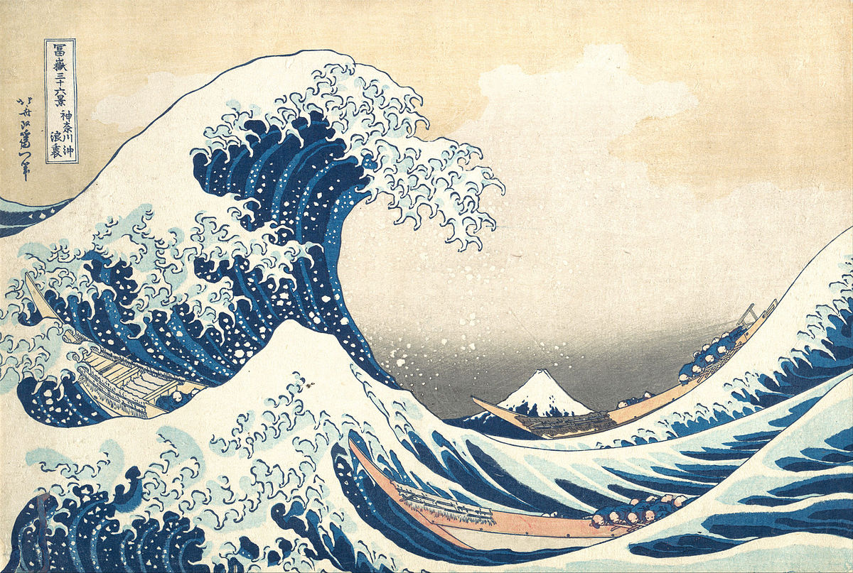
Qur8
Vibes in Real Time
1
Head to a supported location
2
View art aligned with/made in that space

Slide 57
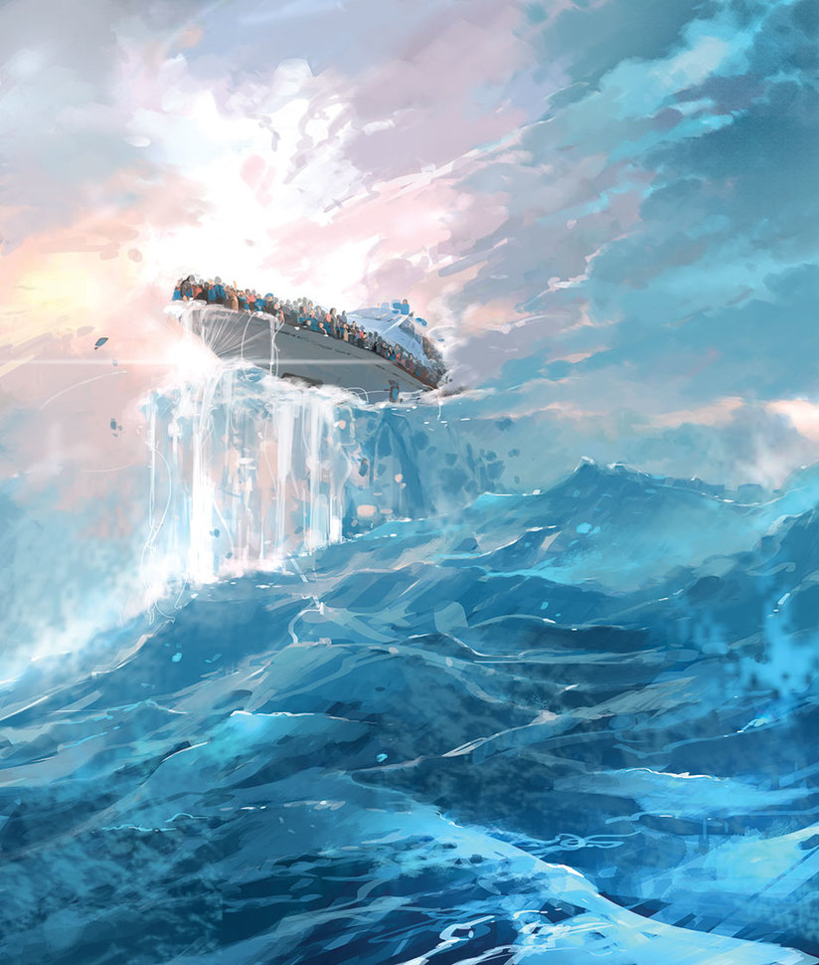
Qur8
Vibes in Real Time
1
Head to a supported location
2
View art aligned with/made in that space
3
Contribute your own

Slide 58
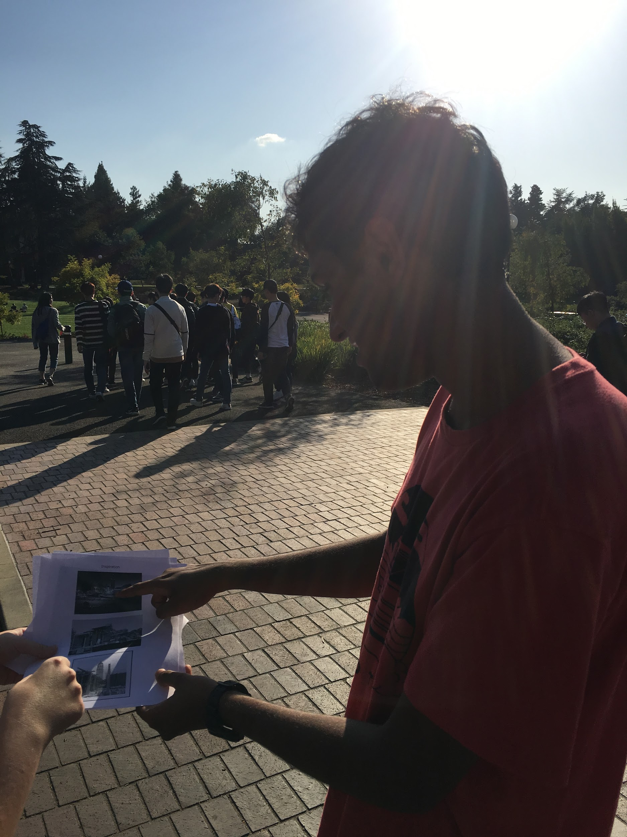
Qur8
Experience Prototype
1
User told to imagine writer’s block
Aman Singh
Stanford Frosh

Slide 59
Qur8
Experience Prototype
1
User told to imagine writer’s block
2
Given pictures from different eras
Aman Singh
Stanford Frosh

Slide 60
Qur8
Experience Prototype
1
What Worked: Appreciated the idea of discovering location-specific art
Aman Singh
Stanford Frosh

Slide 61
Qur8
Experience Prototype
1
What Worked: Appreciated the idea of discovering location-specific art
2
What Didn’t: Did not have all the information he wanted
Aman Singh
Stanford Frosh

Slide 62
Qur8
Experience Prototype
1
What Worked: Appreciated the idea of discovering location-specific art
2
What Didn’t: Did not have all the information he wanted
3
Surprises: Suggested frameworks for following artists
Aman Singh
Stanford Frosh

Slide 63
Qur8
Experience Prototype
1
What Worked: Appreciated the idea of discovering location-specific art
2
What Didn’t: Did not have all the information he wanted
3
Surprises: Suggested frameworks for following artists
Aman Singh
Stanford Frosh
4
New Learnings: People want more information

Slide 64
Assumption Valid
People enjoy art associated with specific locations

Slide 65
the articulate team
made with ❤ in
Stanford, California

